Slide 1
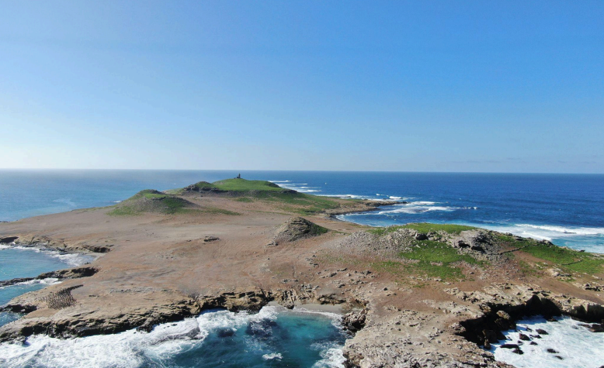
WELCOME TO ISLA SAN JERÓNIMO
A Unique Opportunity Awaits
1 | Isla San Jerónimo

Slide 2
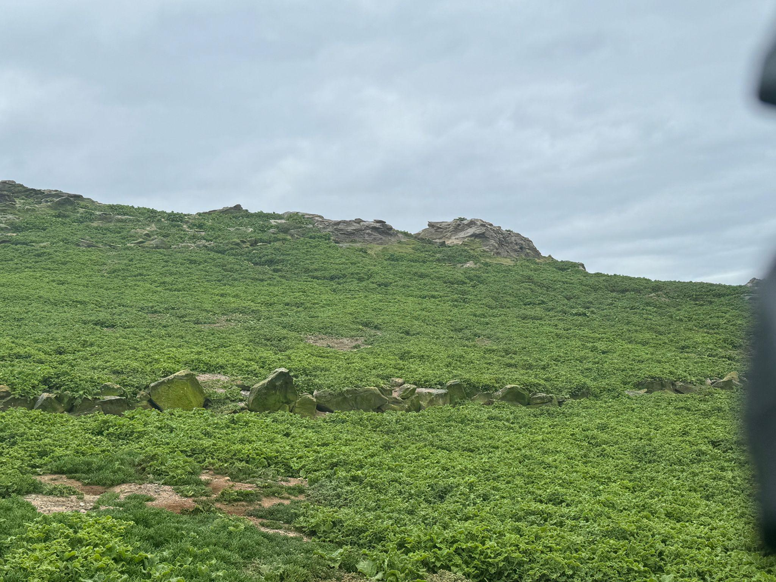
Imagine standing on Isla San Jerónimo, a 48-hectare island just off the western coast of Baja California, Mexico. With its rugged volcanic cliffs, sandstone outcrops rising 40 meters above sea level, and the vast expanse of natural seabird guano covering the land, this is a place where untapped potential meets natural beauty.
Isla San Jerónimo is more than just land. It's an opportunity. Baja Wanu S.A. de C.V. holds exclusive mining rights for the island’s guano—a resource rich in phosphorus, essential for agriculture. The concession, valid through 2055 and renewable, offers a secure, long-term investment. As global demand for sustainable, organic fertilizers continues to rise, this guano-rich island is perfectly positioned to meet the need.
This presentation outlines the full potential of this opportunity—from the volume of resources available to the sustainable practices in place to ensure long-term growth.
2 | Isla San Jerónimo
2 | Isla San Jerónimo

Slide 3
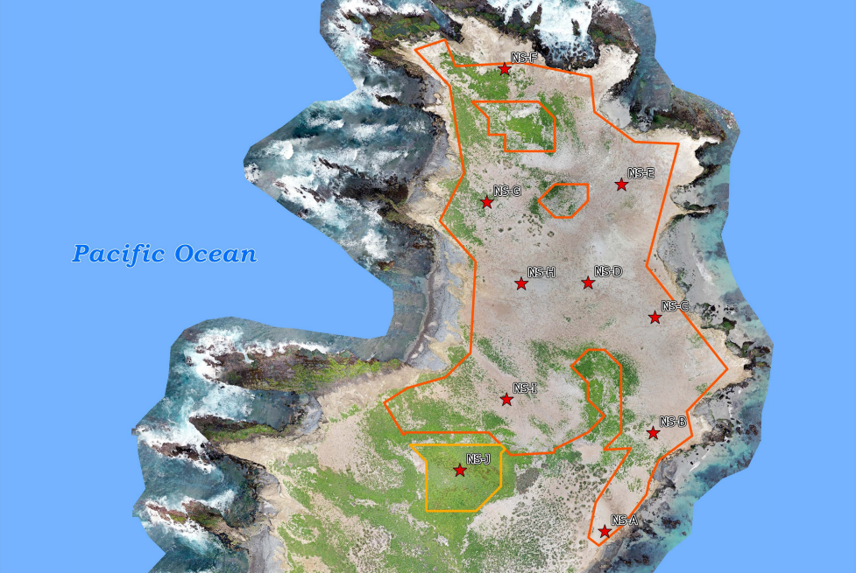
The Resource: Seabird Guano
Formed over decades of seabird activity, this natural deposit is rich in phosphorus—a key ingredient for organic and sustainable fertilizers. With concentrations ranging from 3% to over 25%, the guano on this island is of premium quality.
In 2024, a comprehensive study of the island revealed that Isla San Jerónimo holds over 67,000 cubic meters of guano, equivalent to over 100,000 metric tons. This presents a substantial and reliable resource ready for market.
67,000 cubic meters of guano reserves, or 100,000 metric tons.
Phosphorus concentrations of 3% to over 25%.
Global demand for organic, sustainable fertilizers is growing rapidly.
To break it down further:
Collected Guano (Warehouse): 80 m³ or 120 mt.
Measured Harvest Zones: 39,805 m³ or 59,708 mt.
Estimated Harvest Zones: 27,478 m³ or 41,217 mt.
This means Isla San Jerónimo offers immediate returns through guano already collected, as well as future revenue from its extensive reserves.
3 | Isla San Jerónimo
Notes:
Please use an updated and approved photo of your shop. You may want one with a team photo in front of the shop - check with your LP

Slide 4
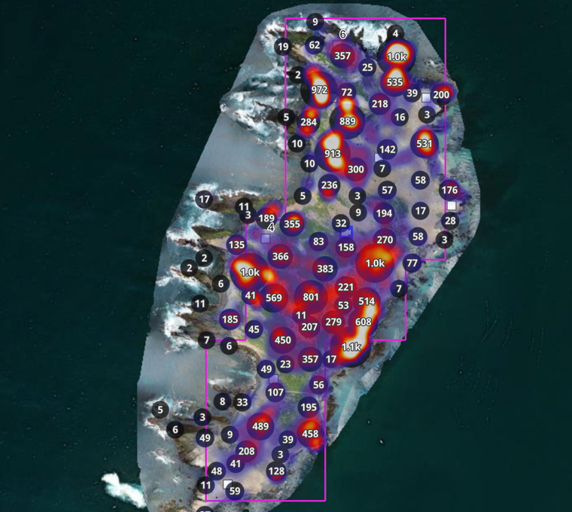
Environmental Stewardship and Impact
Baja Wanu’s commitment to Isla San Jerónimo goes beyond harvesting its valuable guano. They are dedicated to ensuring that the island’s ecosystem remains protected and healthy. The extraction of guano is conducted under the guidance of the Manifestación de Impacto Ambiental (MIA), a robust environmental impact assessment that ensures minimal disturbance to the local wildlife, especially the seabirds.
The MIA is a dynamic document, revised as new data becomes available, meaning the harvesting process is continuously refined to balance resource extraction with environmental sustainability.
Environmental protections in place through the MIA.
Sustainable harvesting practices that preserve the local ecosystem.
Special focus on protecting seabird nesting and breeding seasons.
100s of tons of bird droppings are deposited on the island annually.
This attention to sustainability not only protects Isla San Jerónimo’s unique environment but also ensures that the guano reserves remain viable for future harvests, making it a long-term, responsible investment.
4 | Isla San Jerónimo
Notes:
To make your home purchase go as smoothly as possible, there is no substitute for working with an experienced, licensed real estate agent. Your agent understands the home-buying process and can help you navigate it.
According to the National Association of Realtors’ latest Profile of Home Buyers & Sellers, the percentage of buyers who used the internet in their home search increased to 95%. However, the report also revealed that 95% of buyers that used the internet when searching for a home purchased their home through either a real estate agent/broker or from a builder or builder’s agent. Buyers search for a home online, but then depend on an agent:
to find the home they will buy - 52%
to negotiate the terms of the sale - 47%
to negotiate the final purchase price - 38%
to help understand the process - 60%
The plethora of information now available online has resulted in an increase in the percentage of buyers that reach out to real estate professionals to “connect the dots.” This is obvious as the percentage of overall buyers who used an agent to buy their home has steadily increased from 69% in 2001 to ___ in 2017 and (TBD) in 2018
Agents know the market in your area, will make sure you have the information you need to make good decisions and will protect your interests throughout the transaction. Choose your agent wisely so you can relax and enjoy the process of finding your new home.
According to the 2017 National Association of a Buyer’s Report, buyers want the following services from their agents, in the following order - and I listened. In response, I hope to…
Help you better understand the process
Point out unnoticed property features and faults
Contribute to your ever increasing knowledge of beautiful Colorado neighborhoods
Negotiate the best possible contract terms on your behalf
Shorten the home search process
Provide you with quality lender and industry affiliate referrals

Slide 5
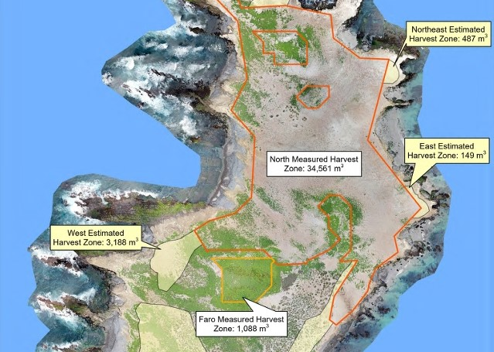
Business Opportunity and Investment Potential
Isla San Jerónimo offers a rare combination of natural beauty and valuable resources with a secure mining concession that runs through 2055. This island’s guano reserves represent a low-risk, high-reward opportunity in a market where organic and phosphorus-rich fertilizers are in growing demand.
The concession is transferable and renewable, giving you peace of mind that this resource can be responsibly harvested for decades. This isn’t just about immediate returns; it’s about sustainable, long-term growth. Guano already collected and stored provides a quick entry to market, while the reserves across the island ensure continued profitability.
Mining concession valid until 2055, renewable and transferable.
Immediate returns with stored guano ready for sale.
Long-term potential with vast reserves still to be harvested.
Growing global demand for phosphorus-rich fertilizers.
By choosing to invest in Isla San Jerónimo, you’re tapping into a highly sought-after commodity, all while contributing to a sustainable future. The market for organic fertilizers continues to expand, and with Isla San Jerónimo’s premium phosphorus content, you’re positioned to benefit from this global trend.
5 | Isla San Jerónimo

Slide 6
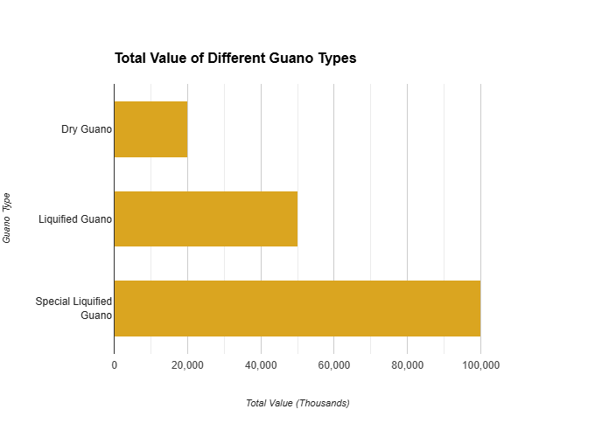
GUANO VALUE ANALYSIS
Dry |  | Kilo | Ton | Concession | TOTAL
Wholesale |  | $3.30 | $3,300.00 | 100,000 | $330,000,000.00
Retail |  | $10.00 | $10,000.00 | 100,000 | $1,000,000,000.00
Liquified | Liter | Per Kilo | Per Ton | Concession | TOTAL
8 Liters of Concentrate Per Kilo Dry Guano | $12.00 | $96.00 | $96,000.00 | 100,000 | $9,600,000,000.00
33 LPF /1 SJ | $6.00 | $1,584.00 | $1,584,000.00 | 100,000 | $158,400,000,000.00
6 | Isla San Jerónimo

Slide 7
Do you have any questions or requests?
Robert Tait
Downing Street Group
robert.tait@engelvoelkers.com
Direct ‭+1(303) 888-0194
www.evprivateoffice.com/property-ev/artisanal-harvesting-of-seabird-guano
7 | Isla San Jerónimo

